Slide 1



Group 5 - Project on Network Modelling
29-08-2025
Sineshaw Legese Bayu
Rahma Jumaa Sheshe
Frank Chacky
Charles Arnest Obat
Sahar Trabelsi

Slide 2
Project Description
This project introduces the intersection of network analysis and epidemic modeling through a hands-on exploration of disease transmission dynamics. Using a dataset of participants from various countries, to construct social networks based on connection patterns and simulate disease spread using a Susceptible-Infected-Susceptible (SIS) model.
The project demonstrates how network structure influences epidemic outcomes by modeling connections between individuals from the same countries, with Kenya serving as a hub connecting participants from different nations.
Participants explore key epidemiological concepts, including transmission rates (β=0.4), recovery rates (γ=0.1), and intervention strategies, such as mask-wearing and identification of superspreaders.
This project aims to bridge theoretical epidemiology with computational methods to understand and model infectious disease dynamics in networked populations—a critical skill for modern public health analysis.

Slide 3


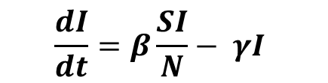
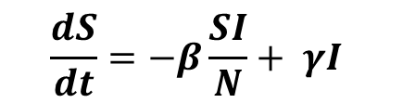
Flow Diagram & Differential Equation
transmission
susceptible humans
infectious
humans
recovery
$$\frac{dS}{dt}=−β\frac{SI}{N}+ γI$$
SIS Model
$$\frac{dI}{dt}=β\frac{SI}{N}− γI$$
Notes:
S(t) = number of susceptible individuals at time t,
I(t) = number of infectious individuals at time t,
N is the total population N=S(t)+I(t)
β is the transmission rate,
γ is the recovery rate.

Slide 4
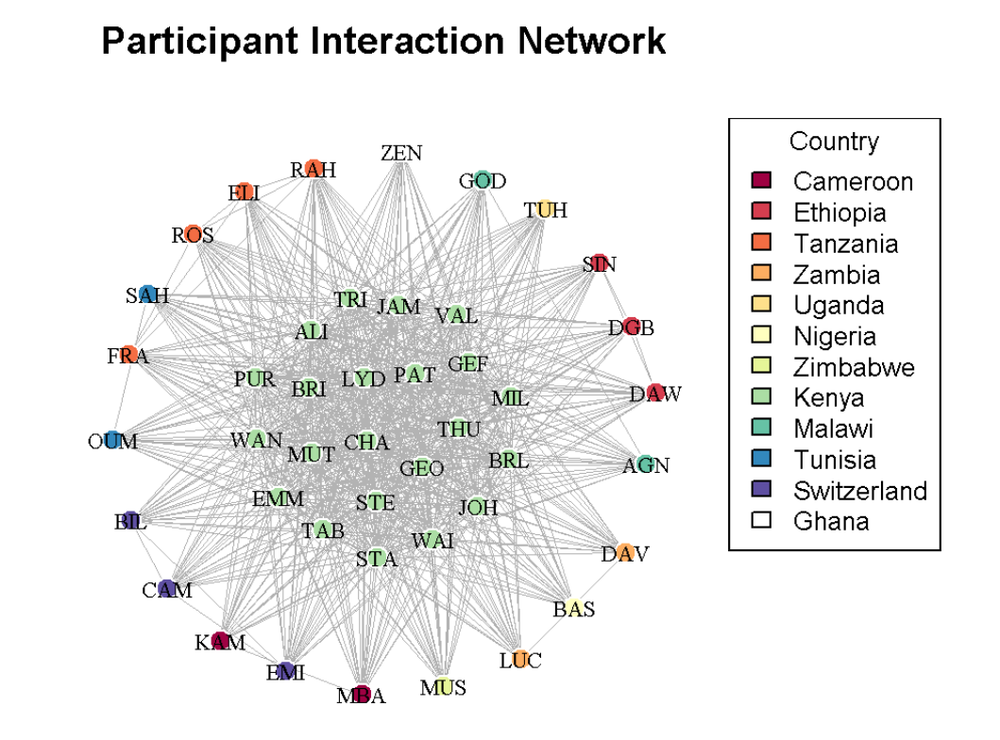
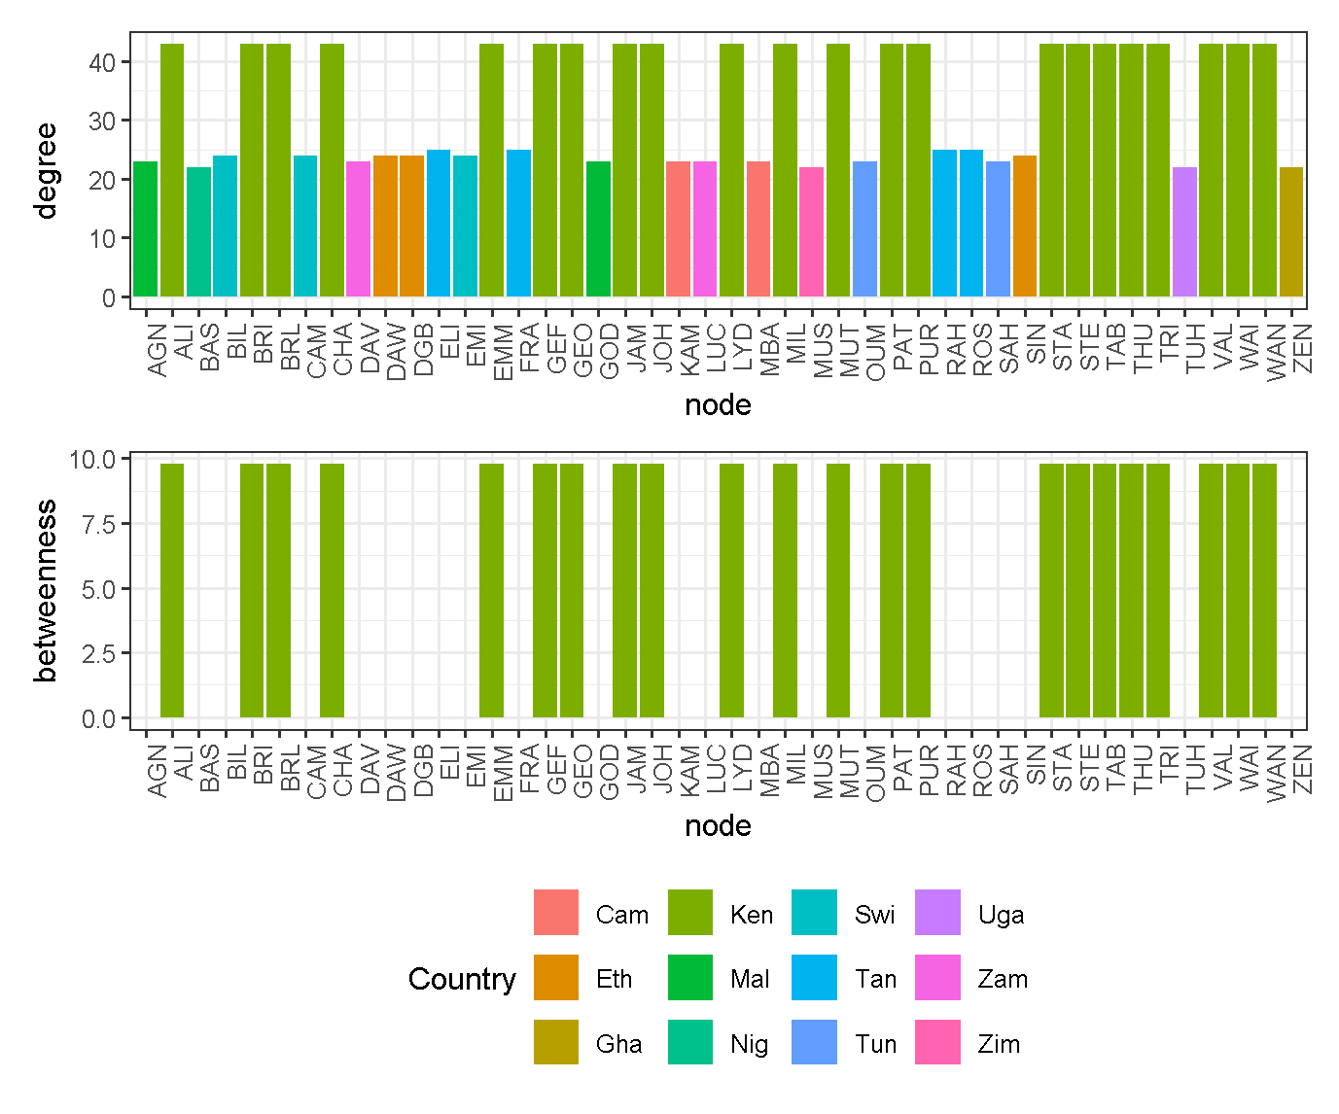
Network Description
Notes:
Total participant: 44, Total connection =731
Number of participant = kenya =22, other 1-4
density: 0.773
Edge_density = 0.77
max_degree = 43
Min_degree = 23
Max_betweenness = 9.77
Min_betweenness=0

Slide 5
Exercise 1.1
What is betweenness centrality. Redraw the network with node sizes proportional to the node betweenness. How does this differ from degree centrality?
Answers
Betweenness centrality measures how often that node lies on the shortest paths between other pairs of nodes in the network.
Example: Connection of
ZN --- BA --- MY --- LY where BA= Highest , MY= second highest
| betweenness = 4 betweenness = 2
SH

Slide 6
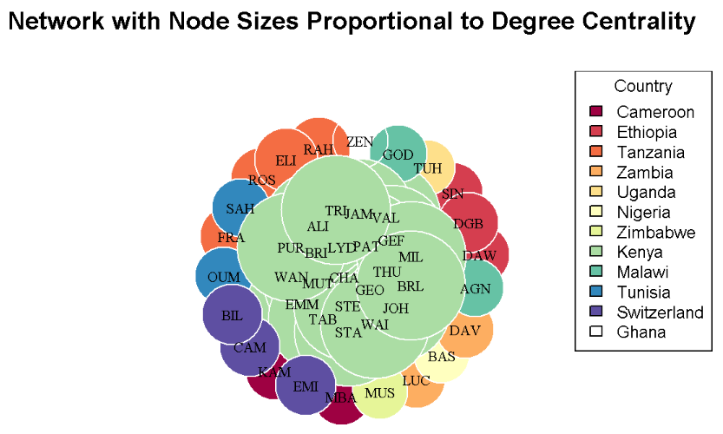
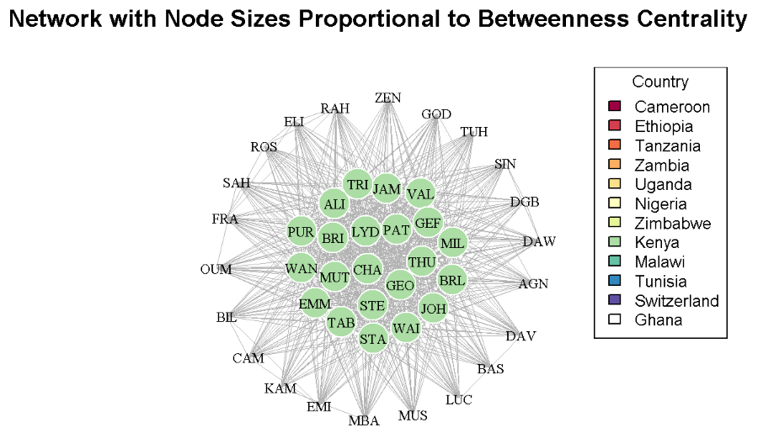
Exercise 1: Network with Node sizes proportional: Degree and betweenness centrality
Notes:
Model Interpretation 1
Nodes = participants (colored by country).
A large node here means the participants interacts with many others (a hub).
Kenya (green nodes) is centrally located, acting as a hub connecting participants from multiple nations.
Model Interpretation 2
Measures how often a node lies on the shortest path between other nodes.

Slide 7
Exercise 1.2: Calculate and compare betweenness centrality for Kenya vs other countries
Kenya
Other Countries
Kenya participants - Mean betweenness: 9.77
Kenya participants are 1.8 times more connected
Kenya act as main bridge in the network.
Other countries - Mean betweenness: 0
Zero mean betweenness for other countries implies that they are still connected but they are at the edges of the network.

Slide 8
Exercise 1.3 - Identify least 3 connected individuals
Answers
THU (Uganda) = 22 connections
BAS (Nigeria) = 22 connections
MUS (Zimbabwe) = 22 connections
These three individuals each have 22 direct connections, which is the lowest degree value.

Slide 9
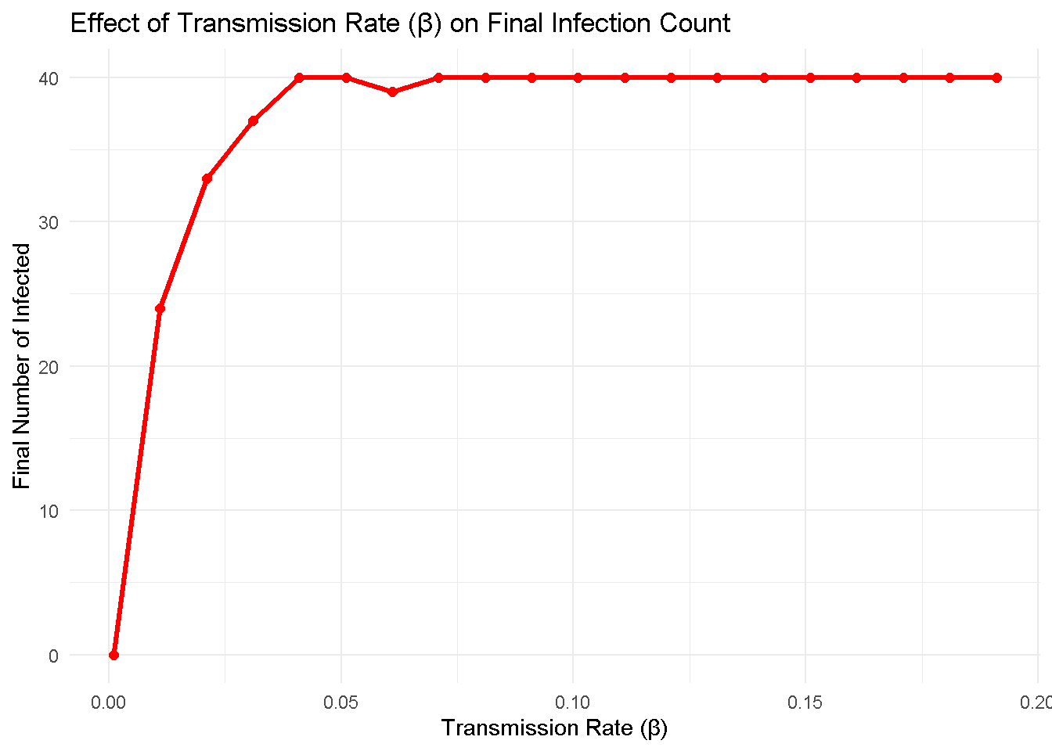
Exercise 2: Parameter Sensitivity Analysis
Exercise 2.1 - Why does the infection plateau? What's the epidemiological phenomenon?
Run SIS model with different β values and plot
The infection plateaus at (Beta=0.071, I=40)
The epidemic reaches an equilibrium where no more people can be infected.
Once the susceptible compartment is exhausted:
The outbreak stops, regardless of how high the transmission rate (β) is.
The plateau simply reflects the infected population limit, not the strength of transmission rate.

Slide 10
Exercise 2.2: What is R₀? How would you use the knowledge of R₀ for disease control? What’s another way to calculate R₀ as Billy showed in class?
Basic reproductive number(R₀) is the average number of secondary cases caused by infected person in a completely susceptible population.
Analysis:
When R₀ = 1: The disease neither grows nor dies quickly
When R₀ < 1: Disease dies out
When R₀ > 1: Disease persists and spreads
Another way to calculate R₀ as Billy showed : R₀= β/ (ϒ + τ) where τ is the treatment rate

Slide 11
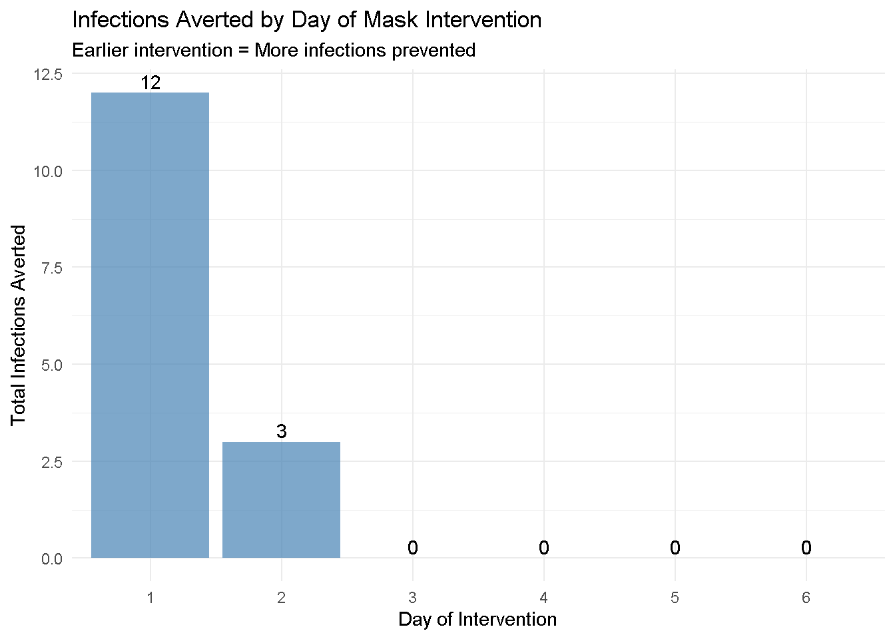
Mask Intervention Analysis
Intervention Timing Results
Day 1 intervention: 12 infections averted
Day 2 intervention: 3 infections averted
Day 3 intervention: 0 infections averted
Day 4 intervention: 0 infections averted
Day 5 intervention: 0 infections averted
Day 6 intervention: 0 infections averted

Slide 12
Question 3.1: Who are the top 6 most connected individuals abased on betweenness? Do they differ from those based on degree centrality? Comment on whether they are different or the same - why?
Degree Centrality
Betweenness Centrality
1 . CHA - 43 edges
2 . EMM - 43 edges
3 . LYD - 43 edges
4 . VAL - 43 edges
5 . JAM - 43 edges
6 . WAN - 43 edges
1 . CHA - 9.772727 edges
2 . EMM - 9.772727 edges
3 . LYD - 9.772727 edges
4 . VAL - 9.772727 edges
5 . JAM - 9.772727 edges
6 . WAN - 9.772727 edges
This suggest that the individuals with the most direct connections (high direct centrality) also play key roles as intermediaries or “bridges” in the network (high betweenness centrality)

Slide 13
Question 3.3: Calculate the superspreader effect based on betweenness centrality, and compare most connected as superspreader and random people as superspreader vs baseline? Do they differ from when using degree centrality
Degree Centrality
Betweenness Centrality
Baseline (no superspreaders): 1150 total infections
Most connected as superspreaders: 1151 total infections ( 0.1 % increase)
Random people as superspreaders: 1150 total infections ( 0 % increase)
Baseline (no superspreaders): 1150 total infections
Most connected as superspreaders: 1151 total infections ( 0.1 % increase)
Random people as superspreaders: 1150 total infections ( 0 % increase
THEY DON’T DIFFER
In the network, the individuals with the most connections(high degree) also happen to be the ones having high bridging(high betweenness).

Slide 14

Exercise 3.4:How many infections are prevented if we consider betweenness centrality isolation?
Top 3 most connected individuals based on betweenness
Targeted Intervention (Isolate top 3 connected) based on betweenness
With targeted intervention: 1077 total infections
Infections prevented: 73
Effectiveness: 6.3 % reduction
WHY?
When we isolate people with the highest betweenness centrality, they can no longer act as “bridges” that pass the disease from one group to another. As a result, 73 infections are prevented that would have happened otherwise.
This means that isolating these key individuals reduces the overall spread of the disease by about 6.3% compared to the baseline (if no one was isolated).
Notes:
We had 1150 total infections

Slide 15
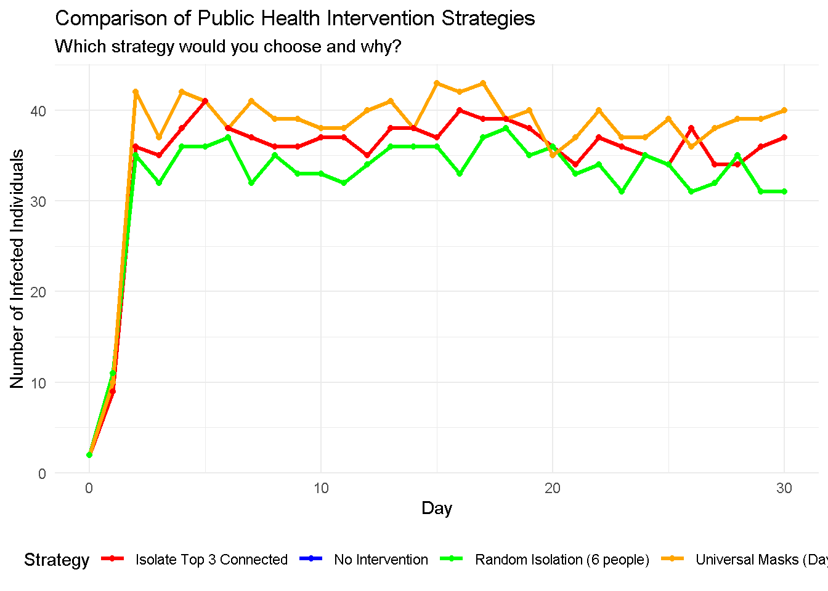
Interventions Comparison
Baseline (no intervention): 1150 total infections
Strategy A (Universal masks Day 3): 1150 total infections - 0 % reduction
Strategy B (Isolate top 3 connected): 1077 total infections - 6.3 % reduction
Strategy C (Random isolation of 6): 1002 total infections - 12.9 % reduction

Slide 16
CONCLUSION
Network structure critically influences disease transmission
Early intervention is more effective than delayed action
Randomly isolating more people is more effective than targeting only a few highly connected individuals.

Slide 17
Thank You
እናመሰግ ናለን
Asante Sana

